Slide 1
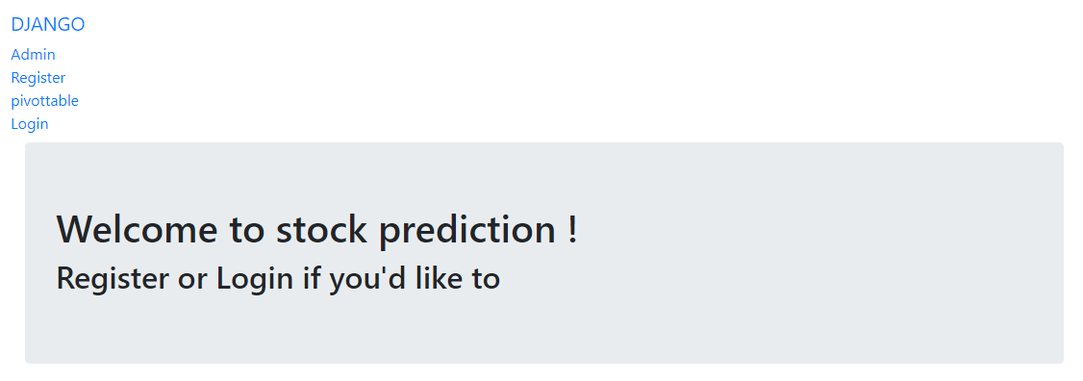
Django web app
After migrate, run server and click url, you will get this page.

Slide 2
Admin- Let the admin to login to admin page
Register- To let new user register their account
Pivottable- To let user to view the data and chart.
Login- To let user to login their accounts.

Slide 3
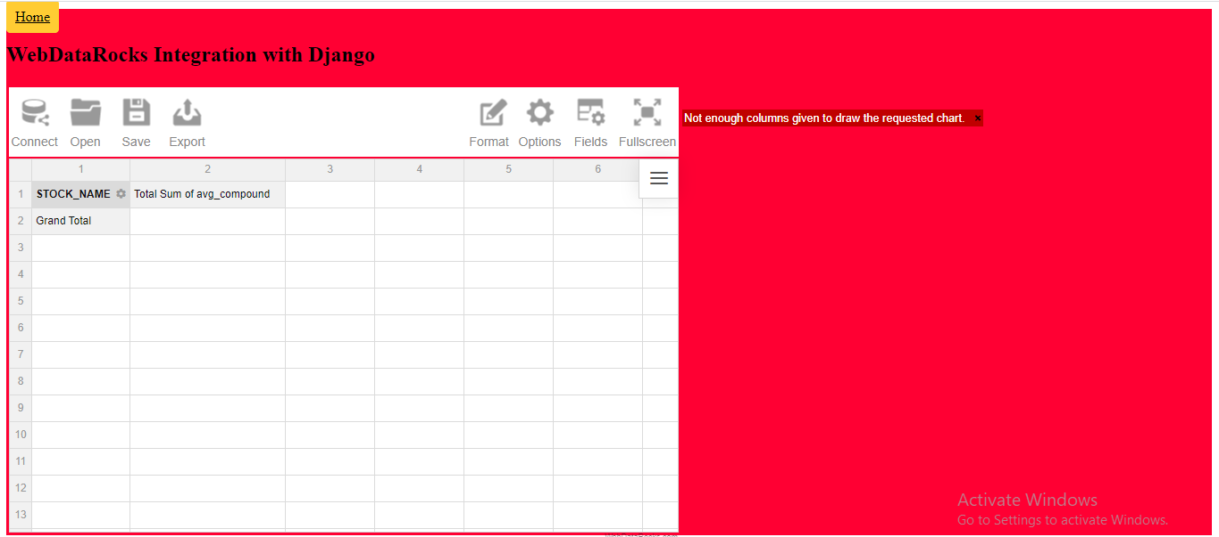
Pivottale page

Slide 4
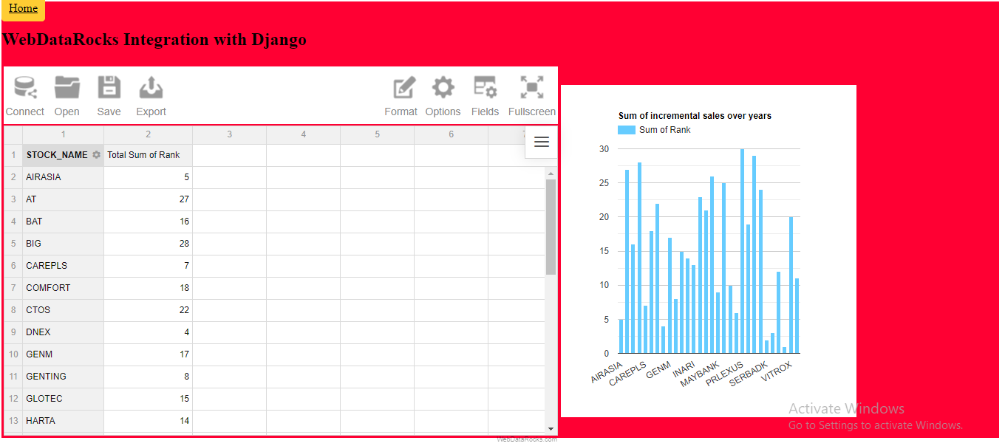
Connect- To import csv/Jason data inside this page
After import you will see this page.

Slide 5
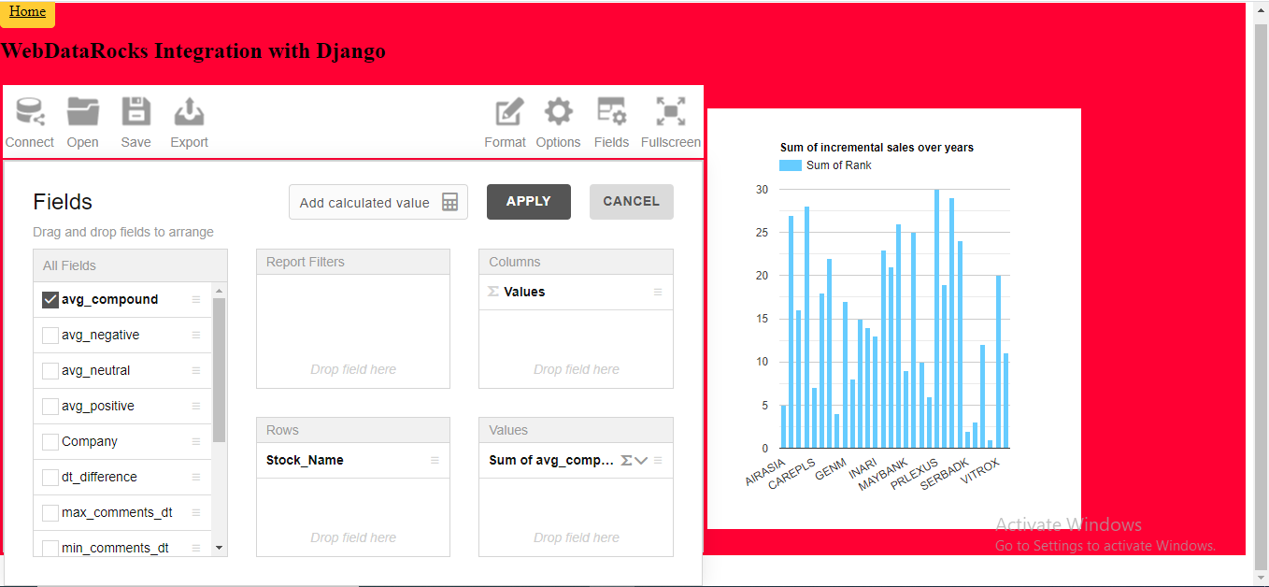
Fields-To let user select which info they want to know, such as neg, pos, neu score for hot stock sentiment analyst. Pls click apply after select.

Slide 6
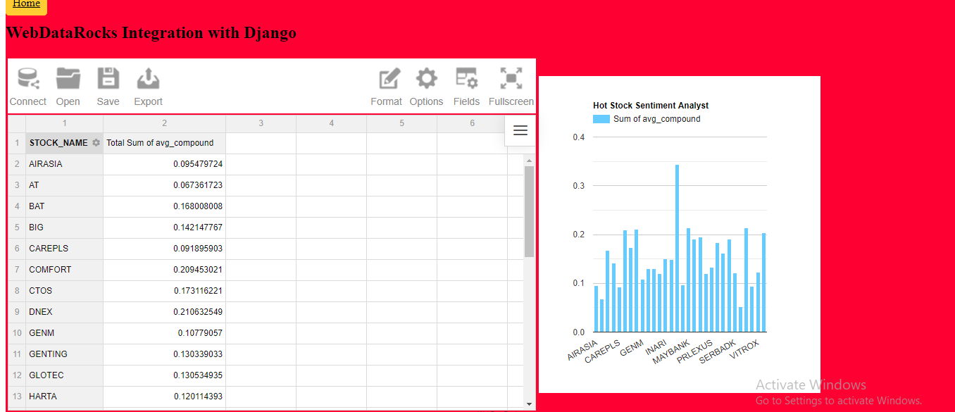
After that you will get the chart.

